Slide 1



Project-1 Speech synthesis
Group Members: 张骥霄,冯柏钧,杨牧之,周安然

Slide 2

Background
Help deaf people to hear again.
Today, a prosthetic device, called the cochlear implant, can be implanted in the inner ear and can restore partial hearing to profoundly deaf people.

Slide 3
Methodology
Based on multi-band envelope cues, synthesize the speech signal with the model Tone-vocode.
Filter the original signal with different bandpass filters, do full-wave rectification and pass a low-pass filer, multiple with a sine wave and finally sum up each components and get the result.

Slide 4
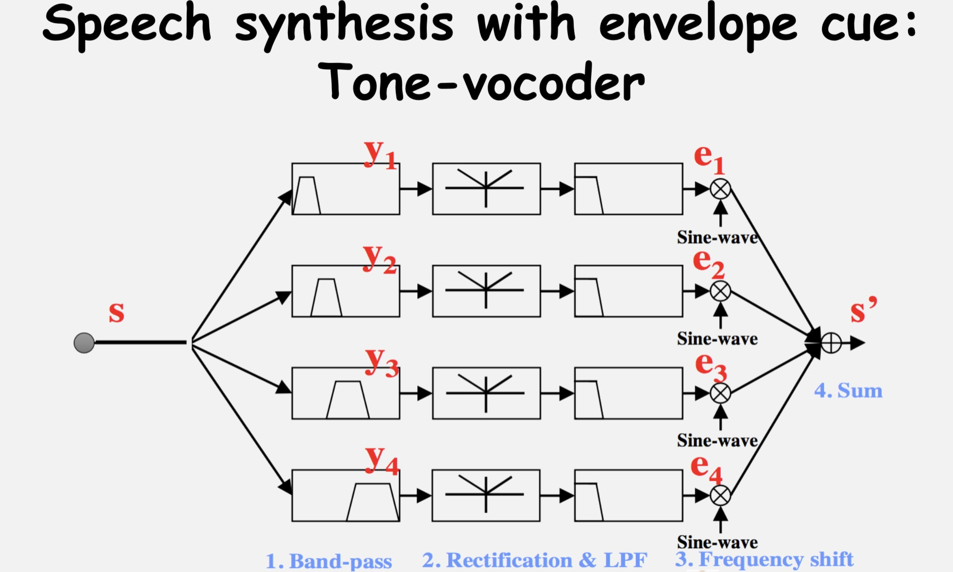

Slide 5
Task-1 张骥霄

Slide 6
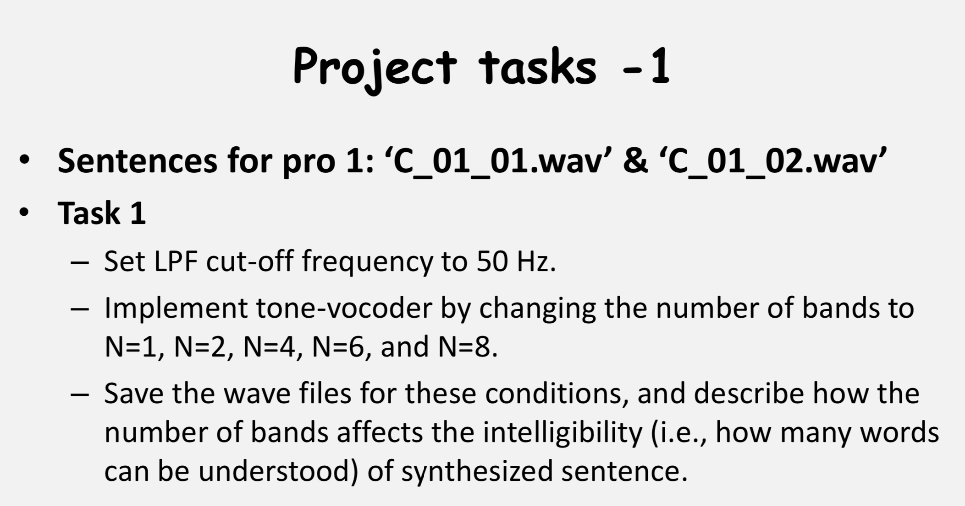

Slide 7
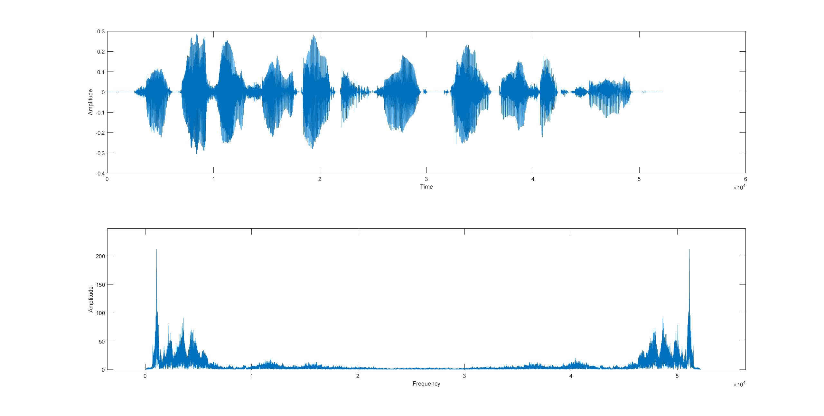
Signal-1

Slide 8
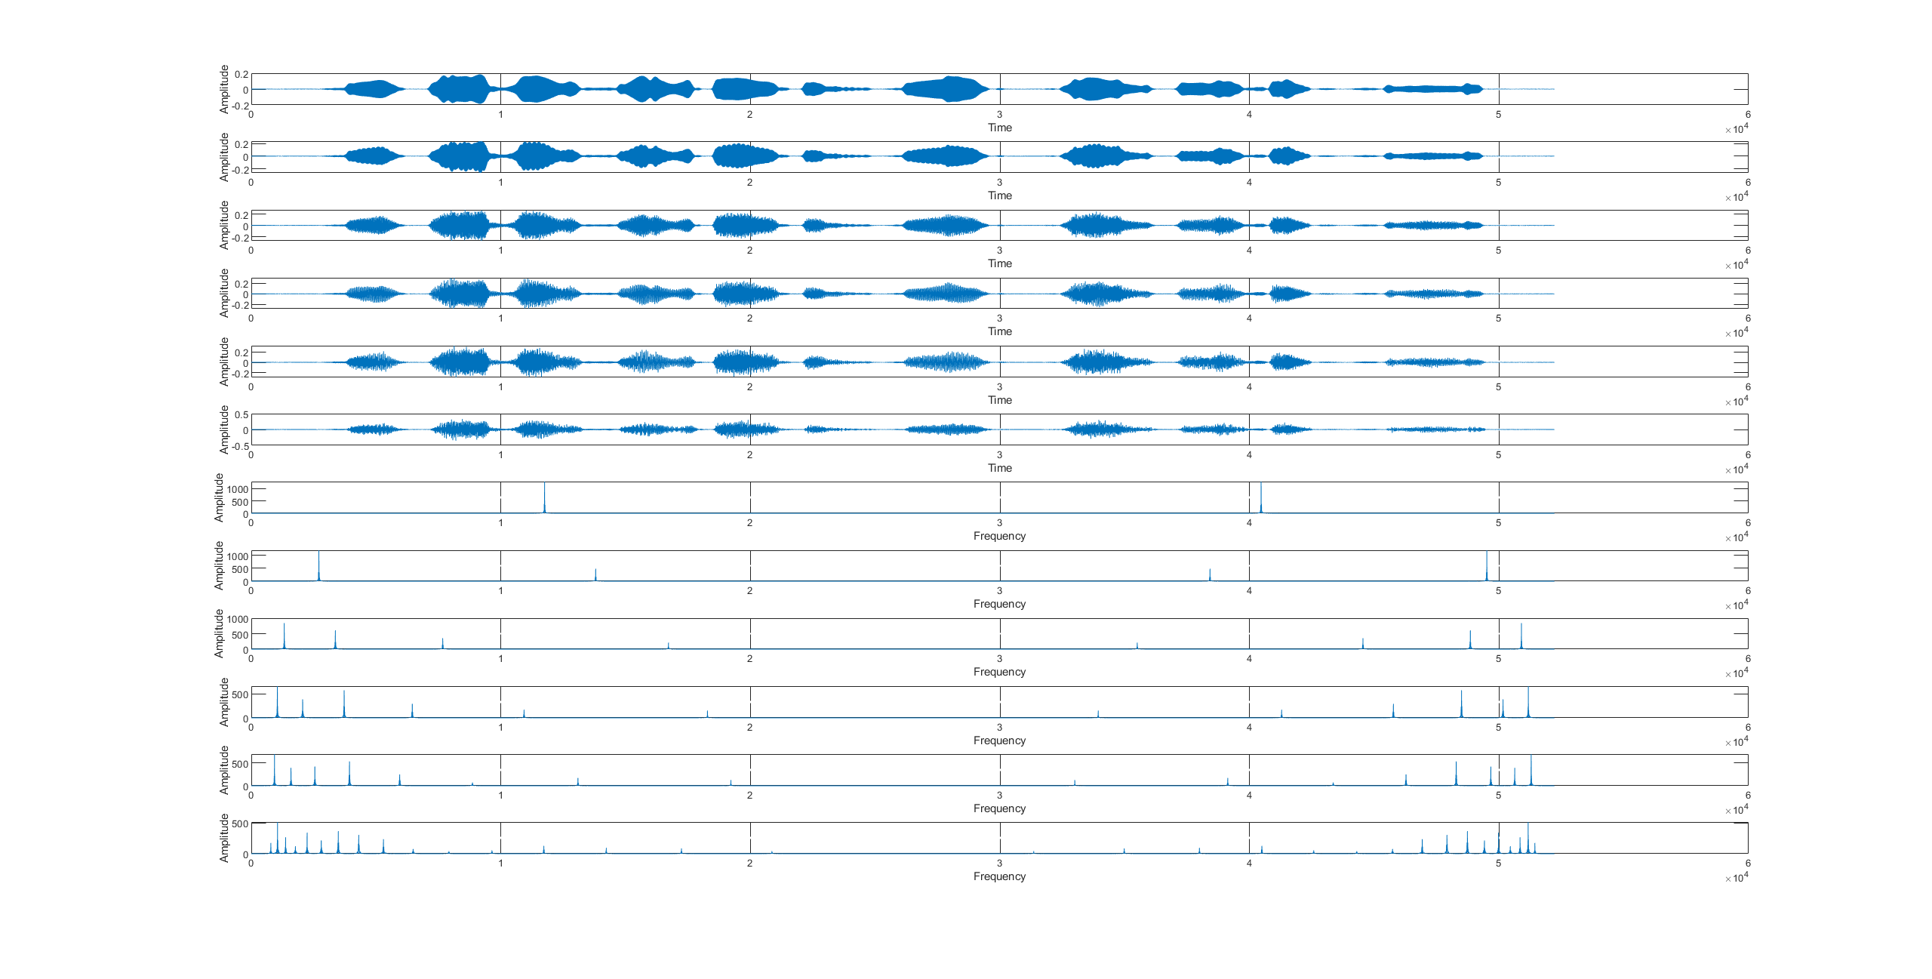
Signal-1 after processing

Slide 9

Signal-1 Audio
Original signal:
Band num = 1:
Band num = 16:
Band num = 2:
Band num = 64:
Band num = 4:
Band num = 6:
Band num = 128:
Band num = 8:

Slide 10
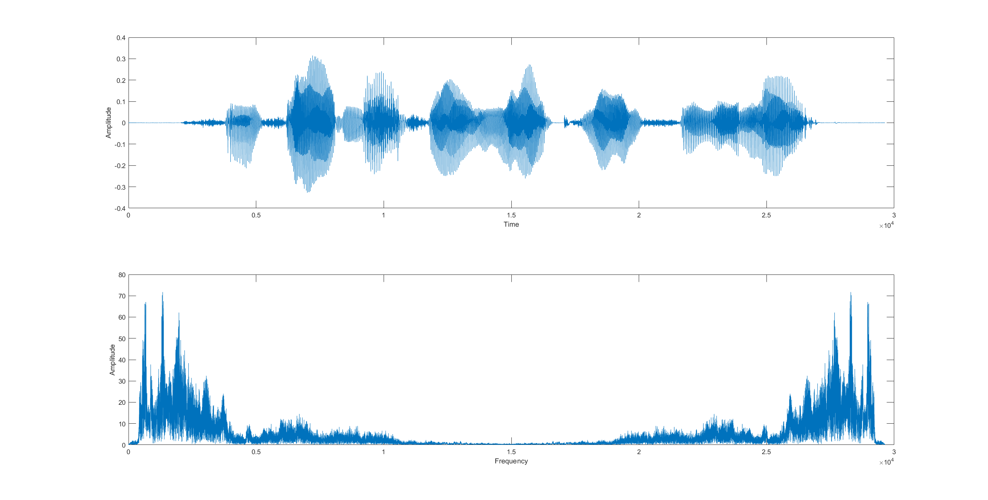
Signal-2

Slide 11
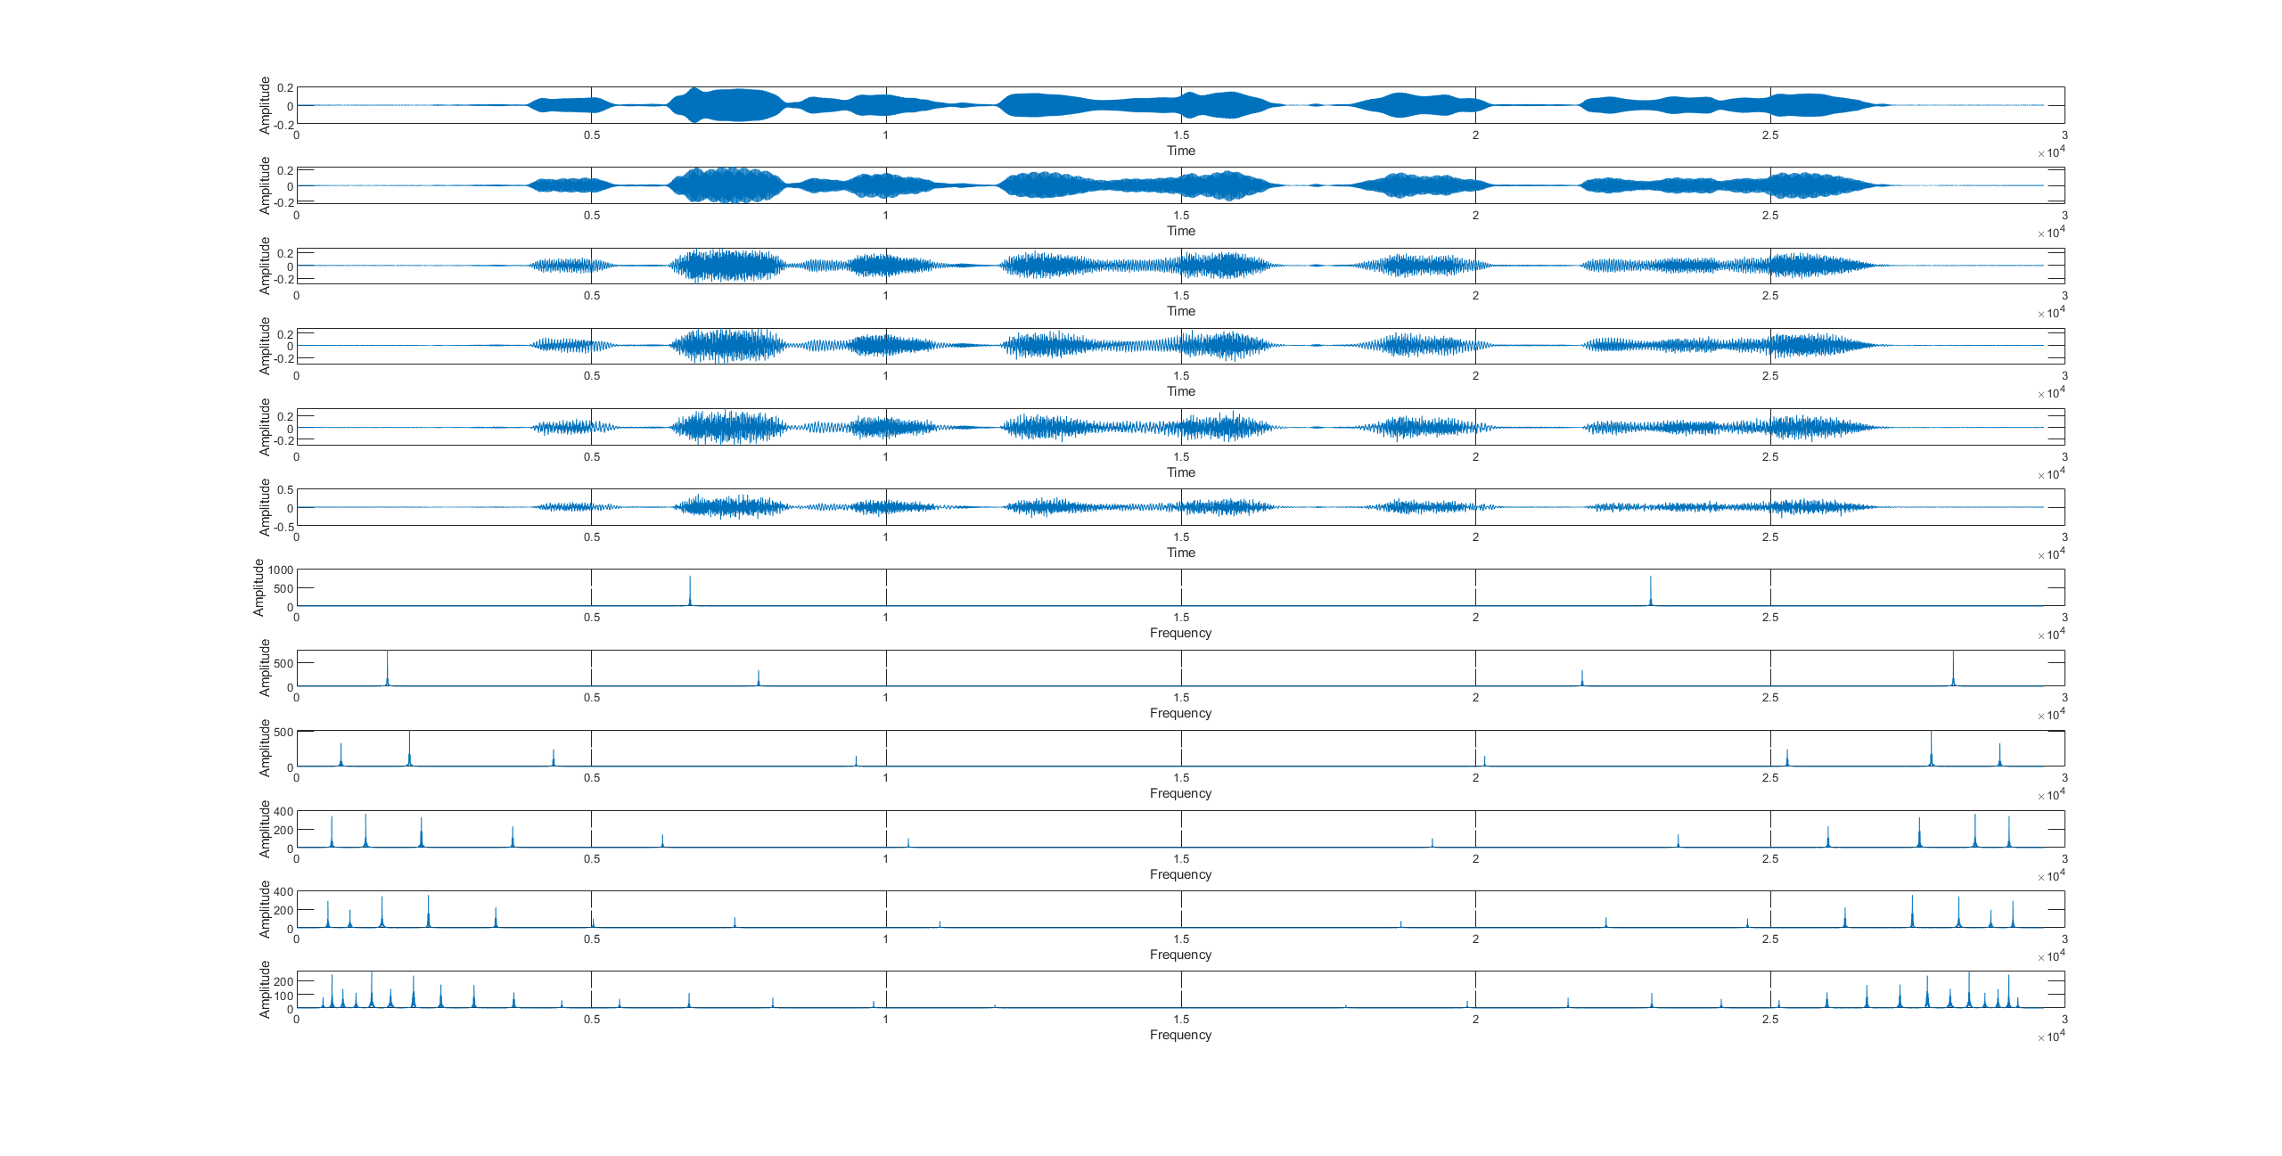
Signal-2 after processing

Slide 12
Signal-2 Audio
Original signal:
Band num = 1:
Band num = 16:
Band num = 2:
Band num = 64:
Band num = 4:
Band num = 6:
Band num = 128:
Band num = 8:

Slide 13
Conclusion
When LPF cut-off frequency is fixed, more bands can hold more information and therefore result in clearer audio

Slide 14
Task-2 冯柏钧

Slide 15
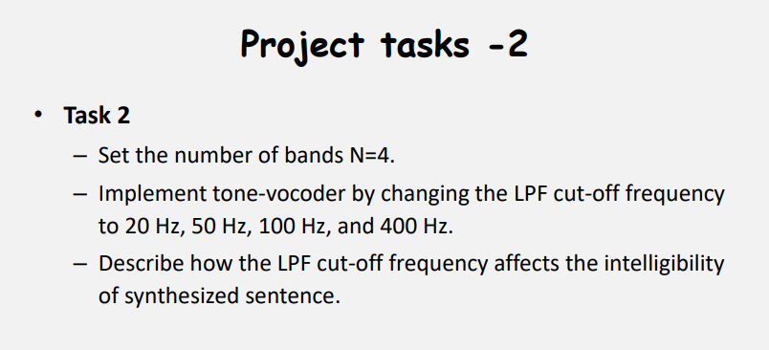

Slide 16
Audios for the result
cut-off frequency (Hz) Initial file | 20 | 50 | 100 | 400
C_01_01.wav
C_01_02.wav

Slide 17
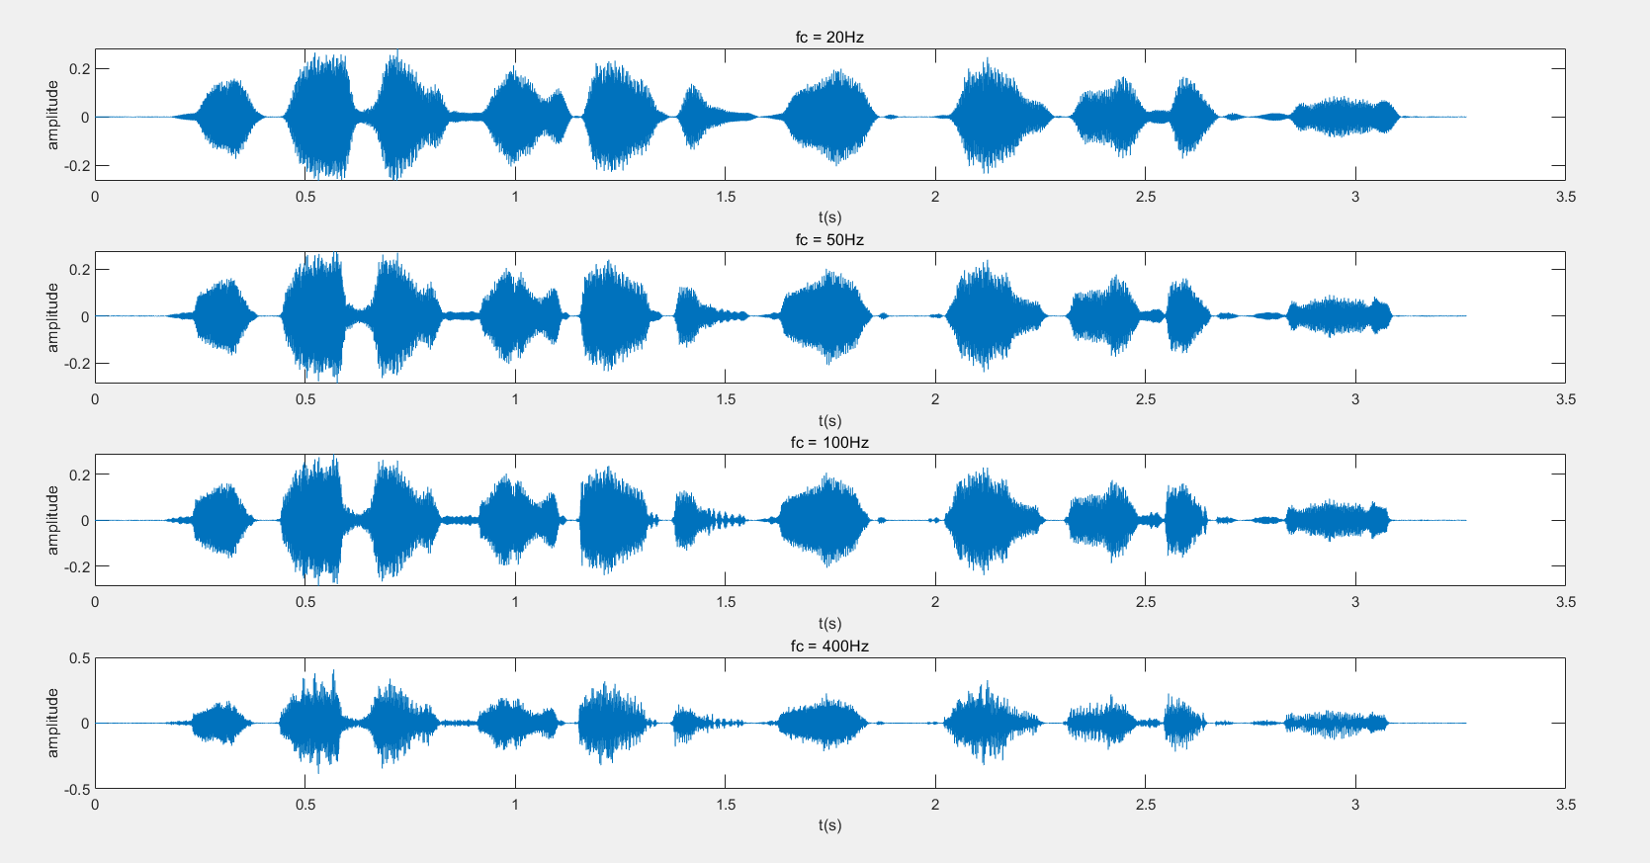
The wave of signal 1 after processing

Slide 18
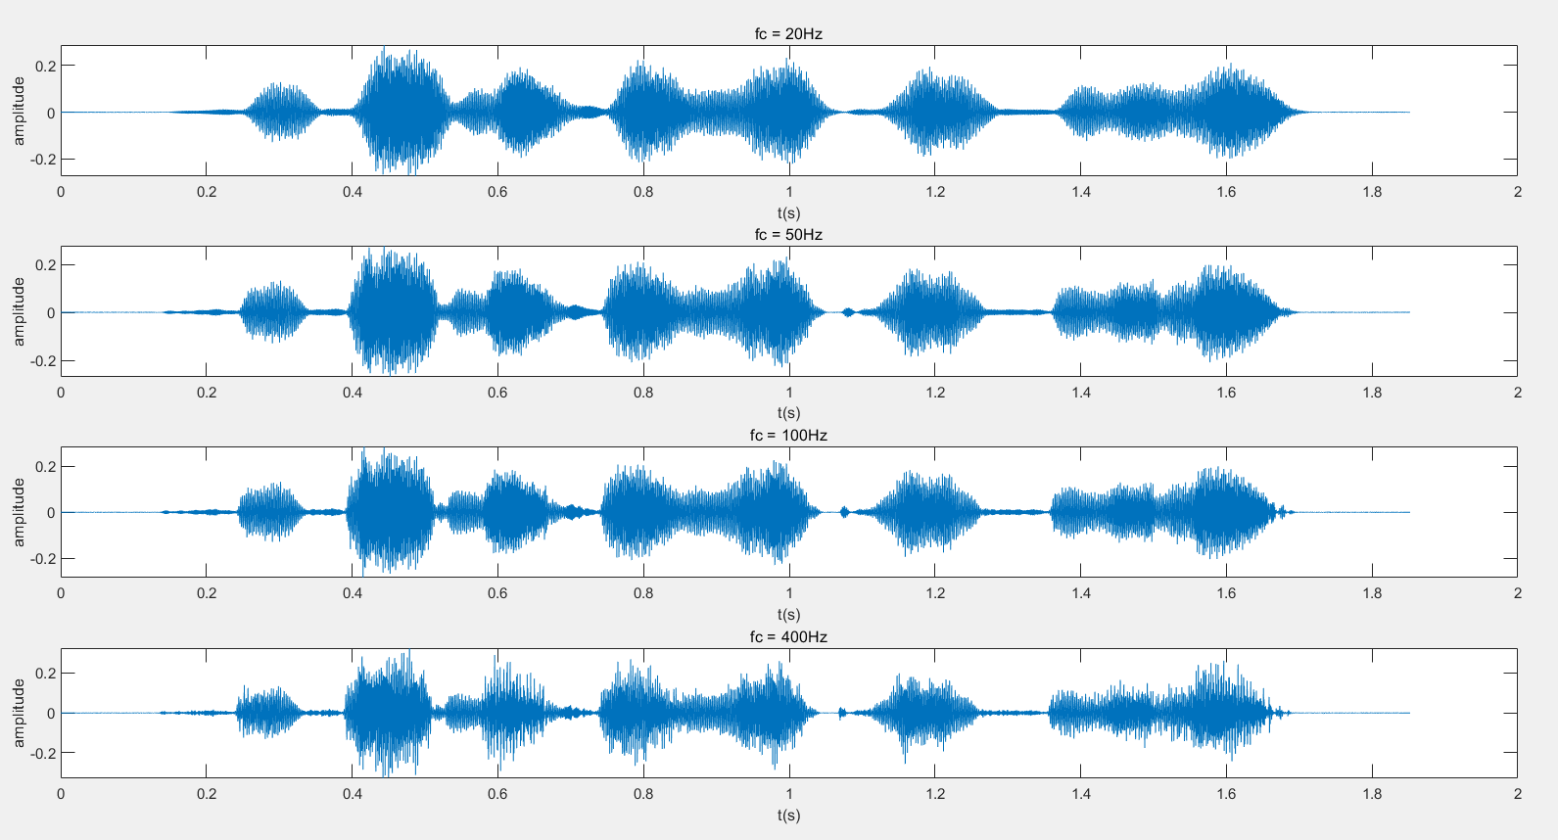
The wave of signal 2 after processing

Slide 19
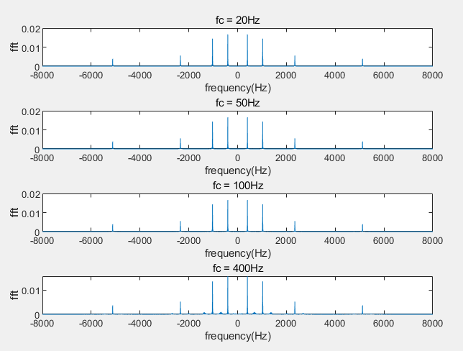
The Fourier Transform of signal 1 after processing

Slide 20
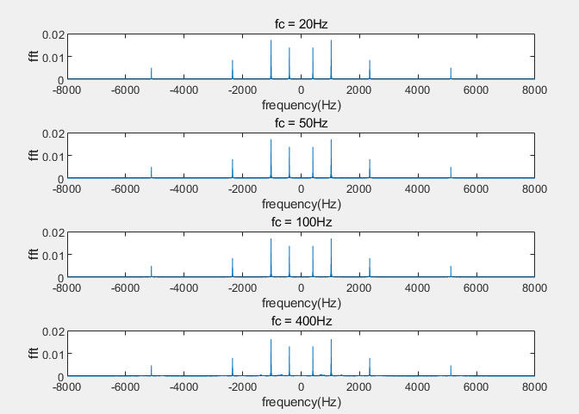
The Fourier Transform of signal 2 after processing

Slide 21
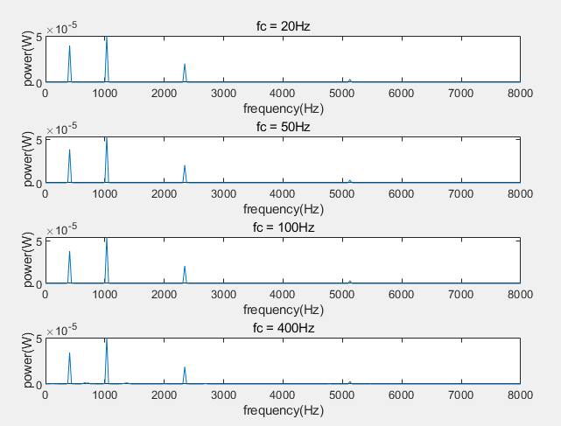
The Power of signal 1 after processing

Slide 22
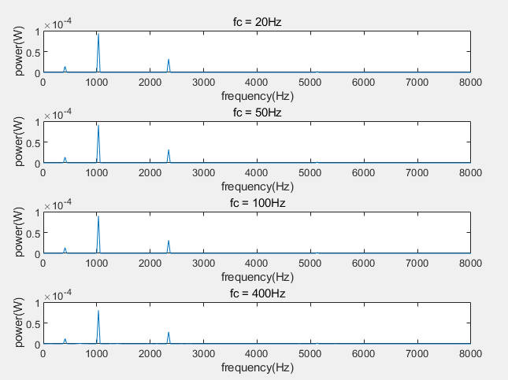
The Power of signal 2 after processing

Slide 23
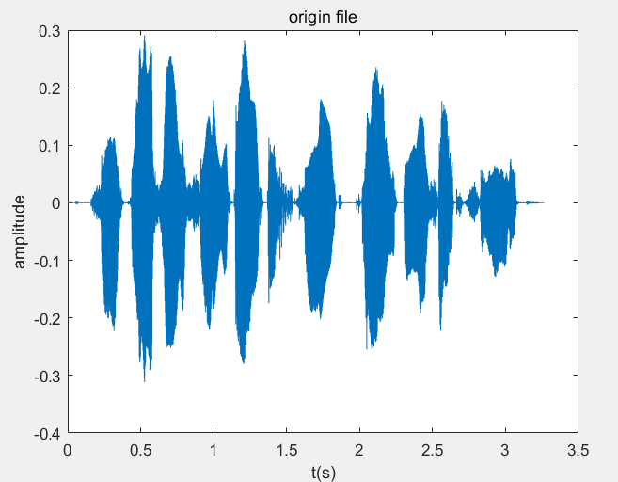
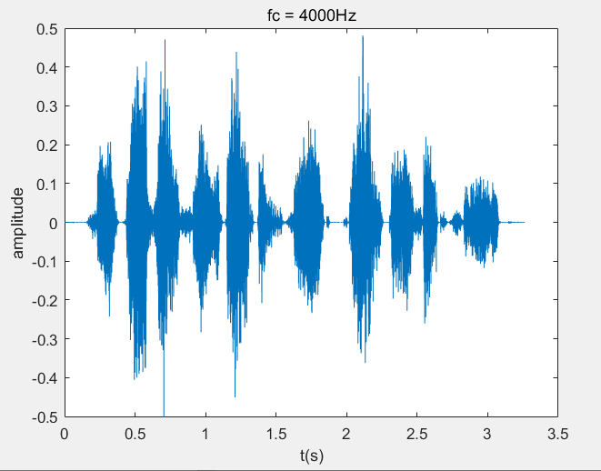
Discussion
Within the given range, as the LPF cut-off frequency increases, the voice of people becomes clearer.
I design my program with the thinking of functional programming.
Encapsulate my codes to make my work more clear and readable.
I test the LPF cut-off frequency to be 4000Hz, it is clearer than the previous work, however, there still exists significant difference with Original file.

Slide 24
Task-3 杨牧之

Slide 25
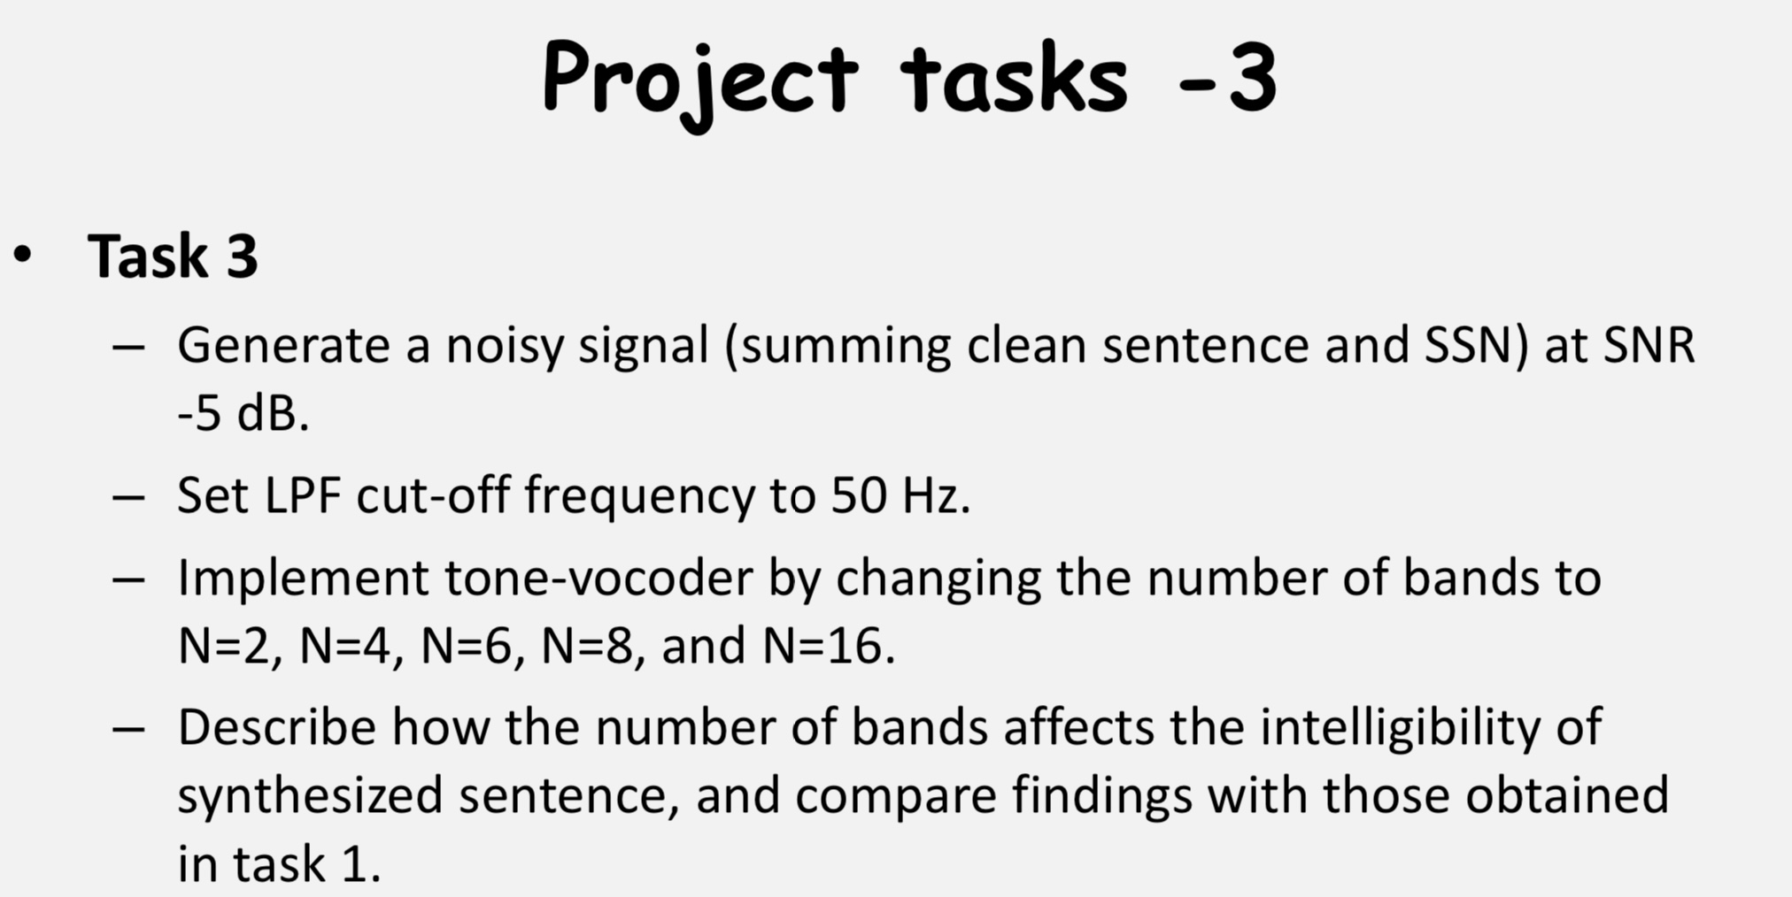

Slide 26
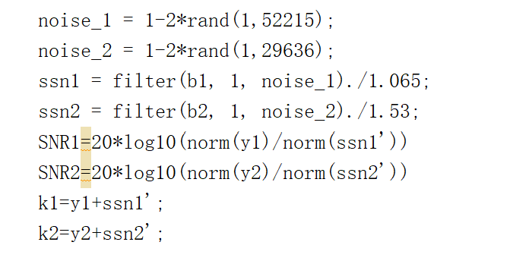
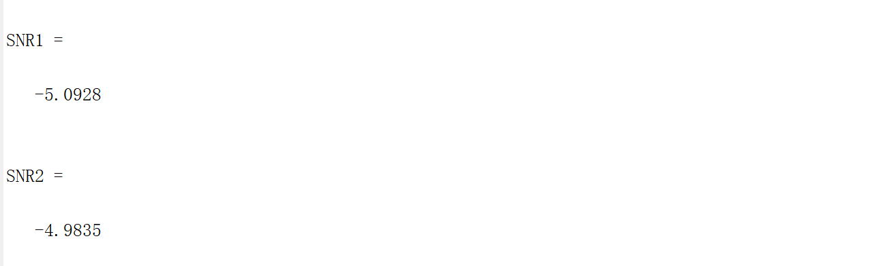
Generate noise and adjust the SNR to -5dB

Slide 27
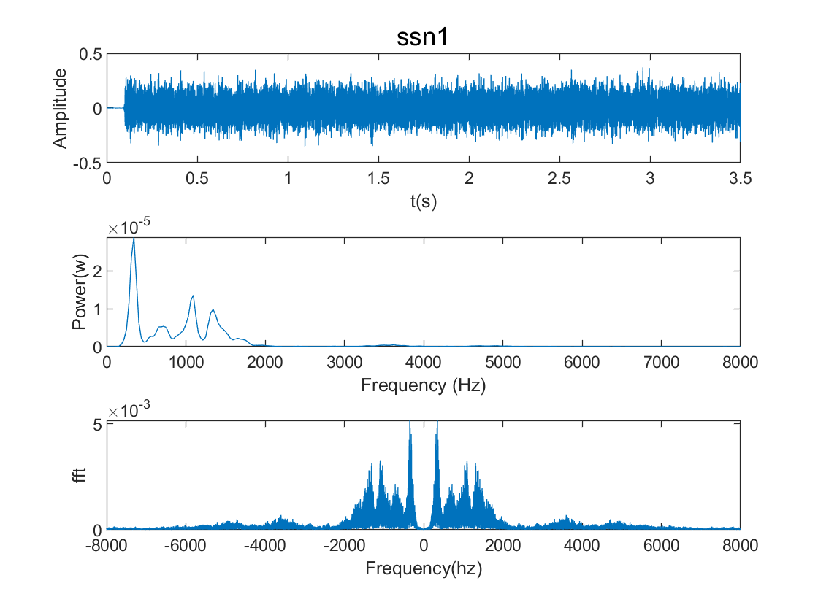
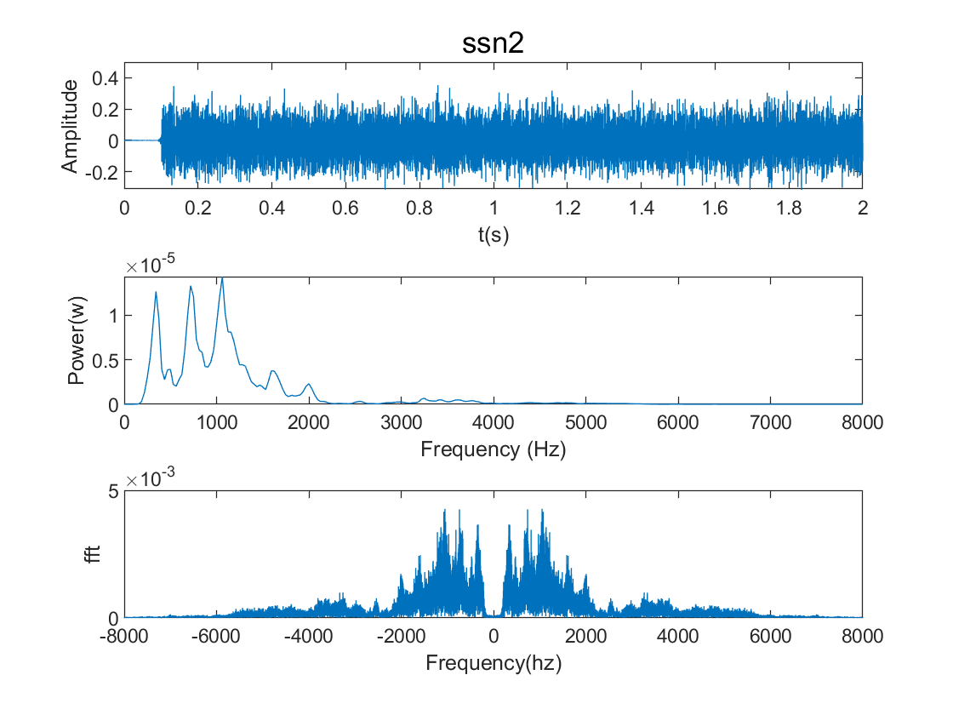
Original noise signal

Slide 28
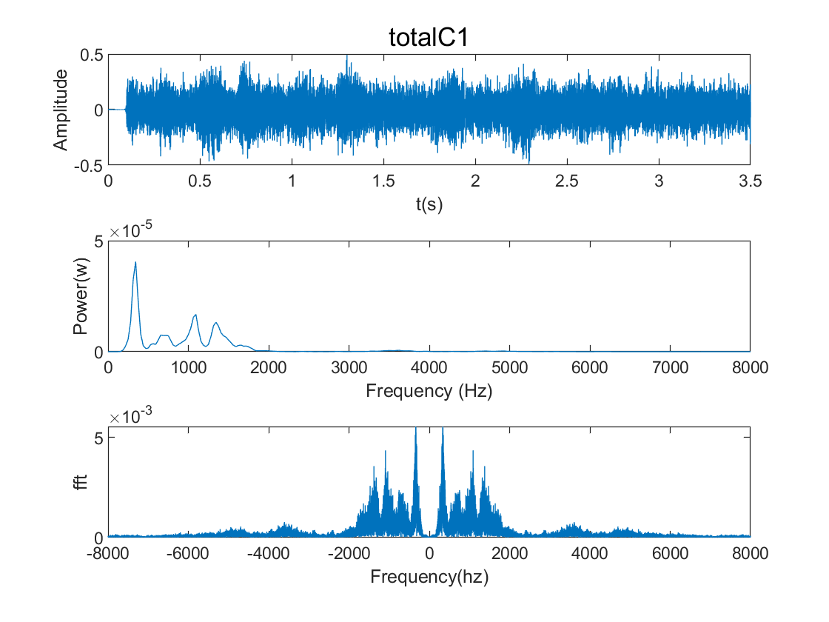
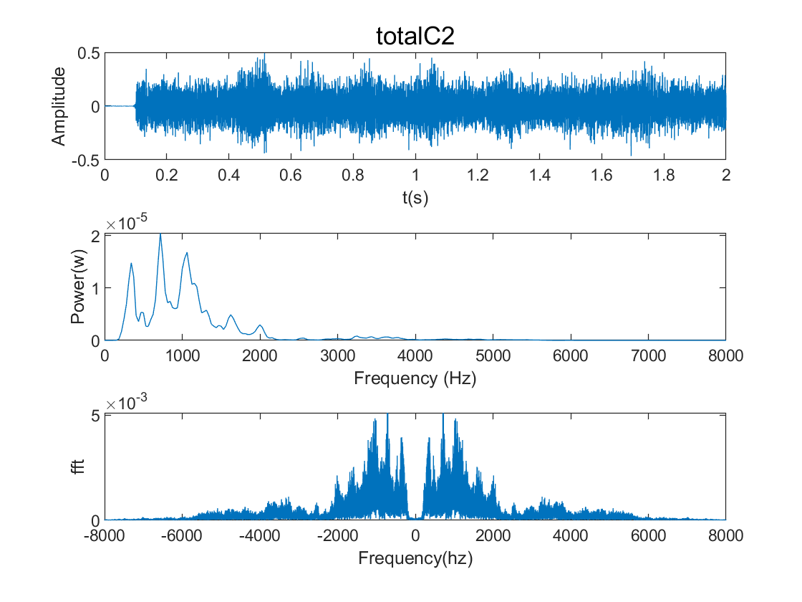
The sum of noise signals and input signals

Slide 29
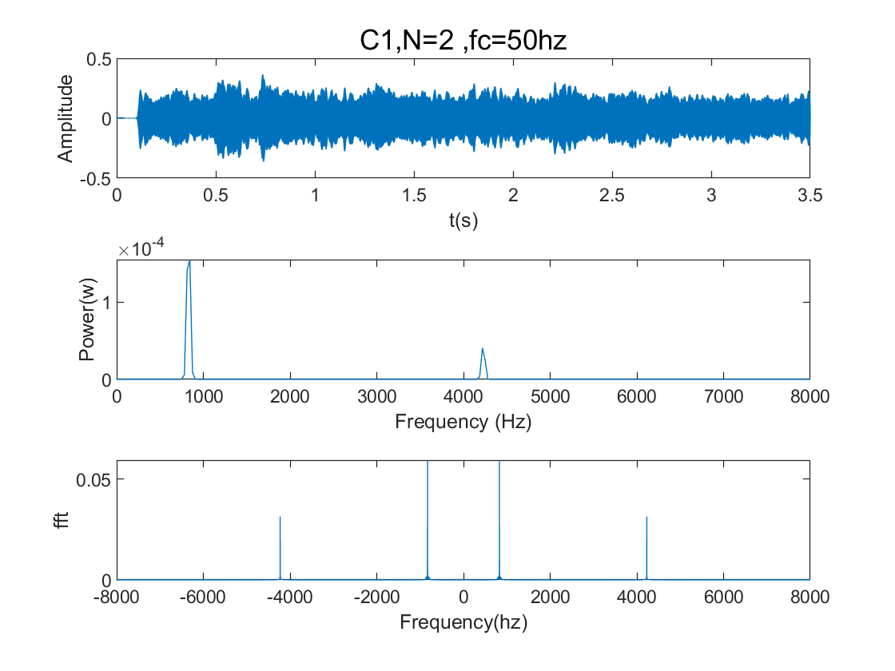
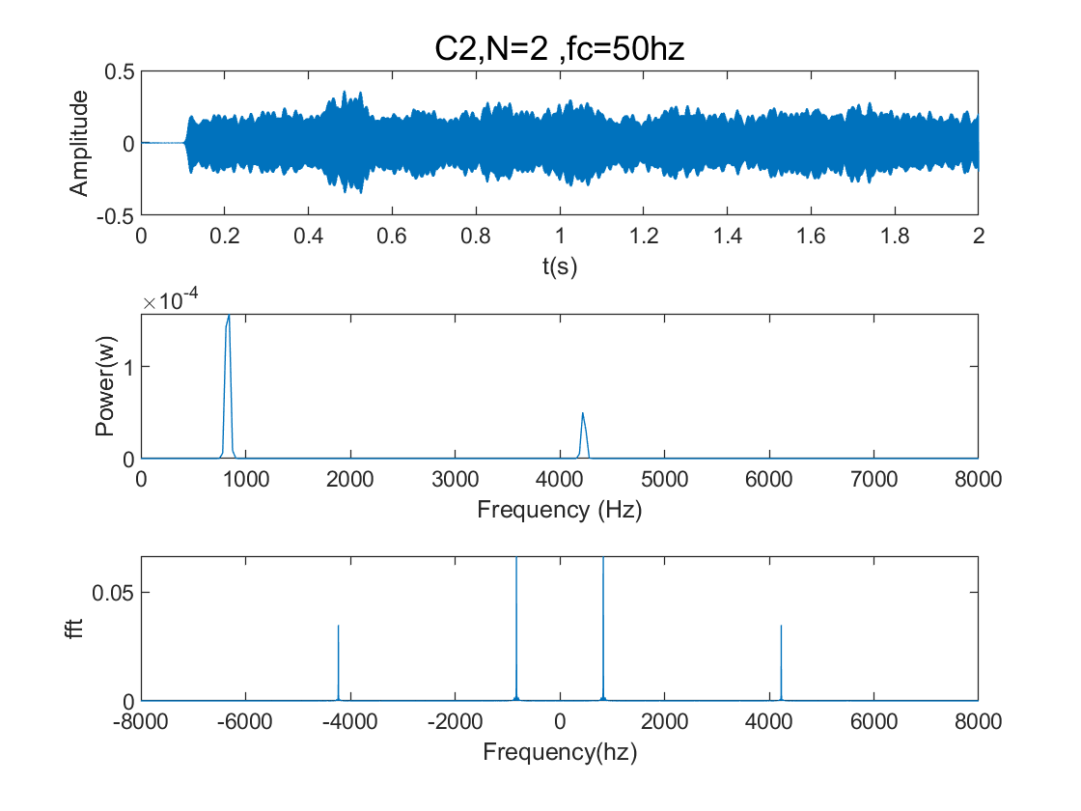
Results

Slide 30
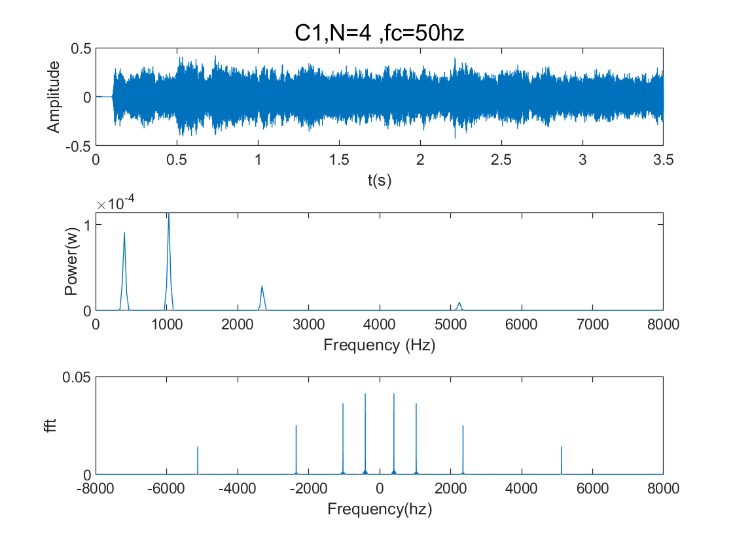

Results

Slide 31
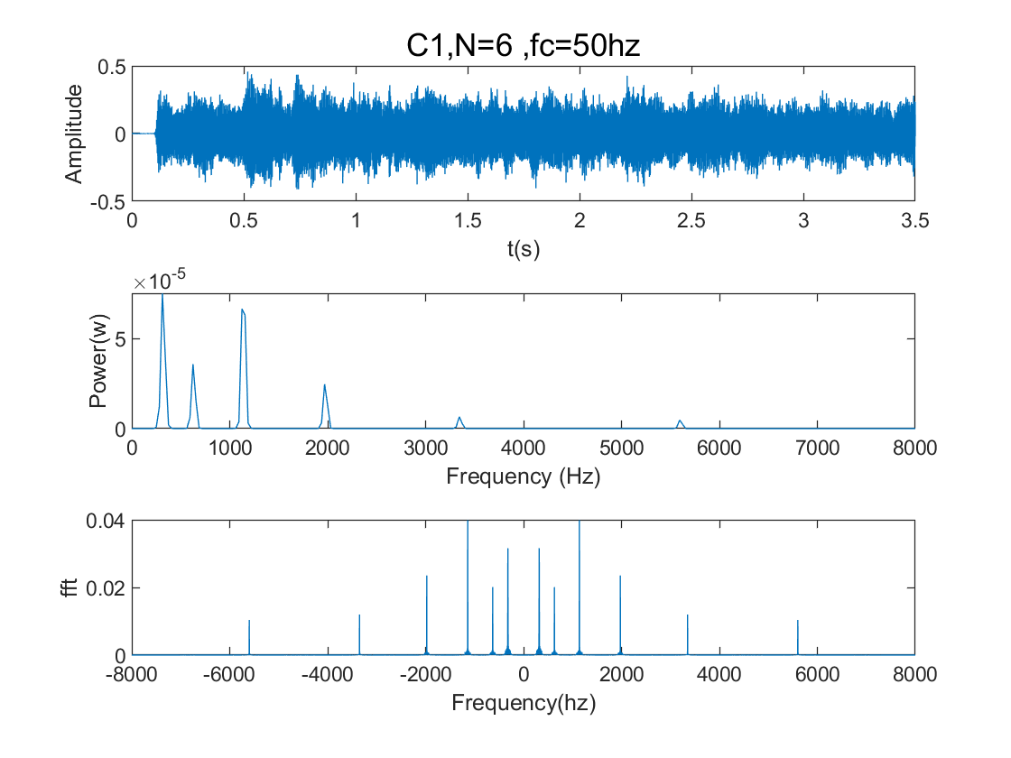
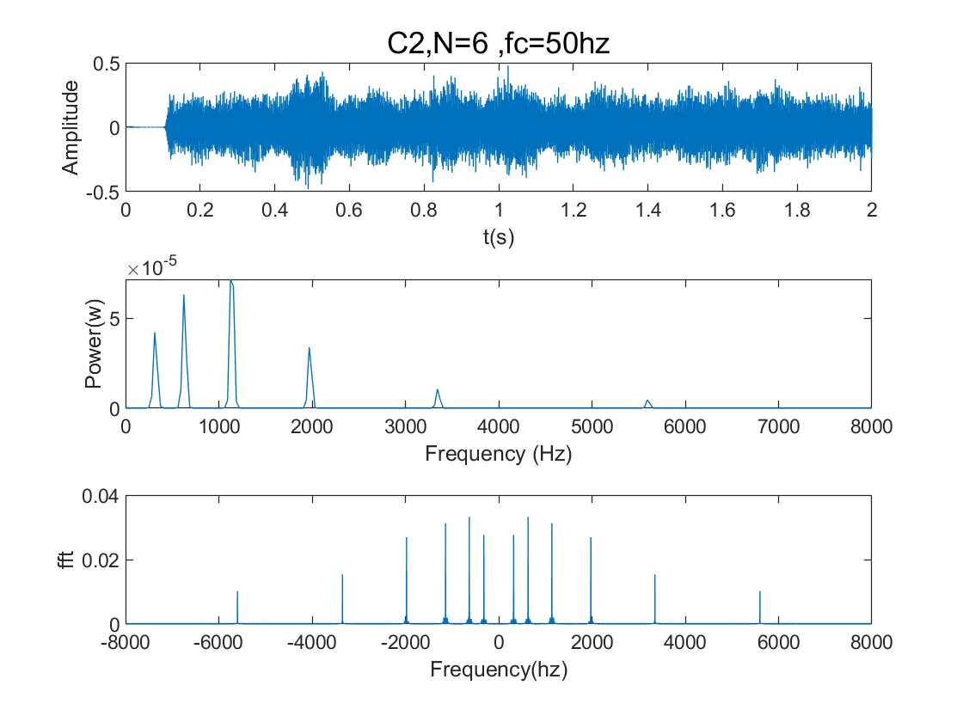
Results

Slide 32
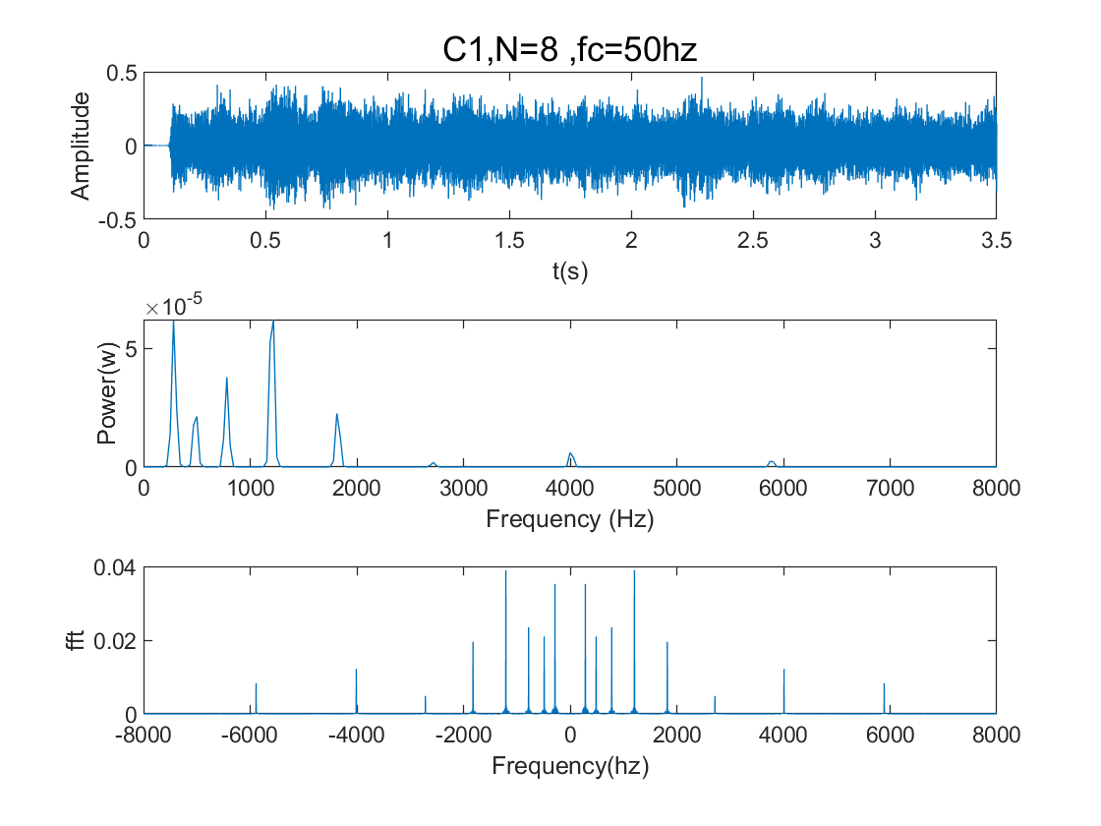

Results

Slide 33
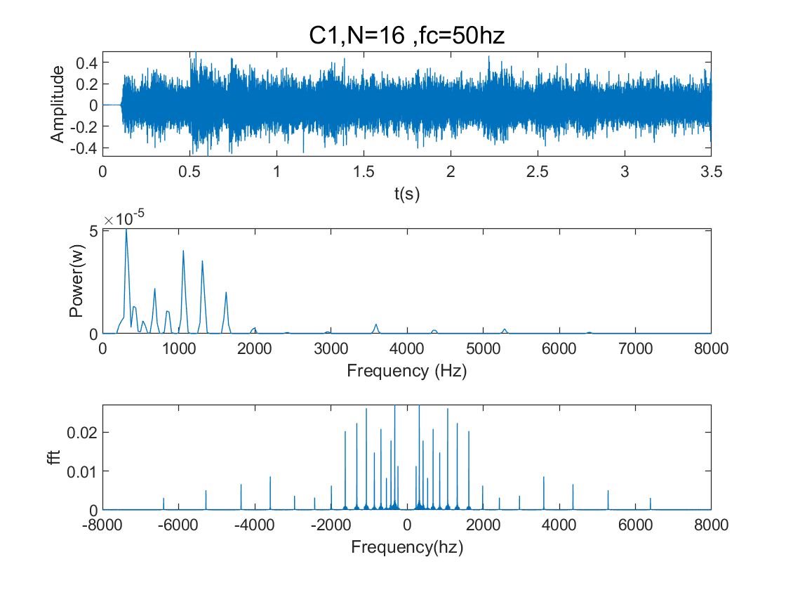
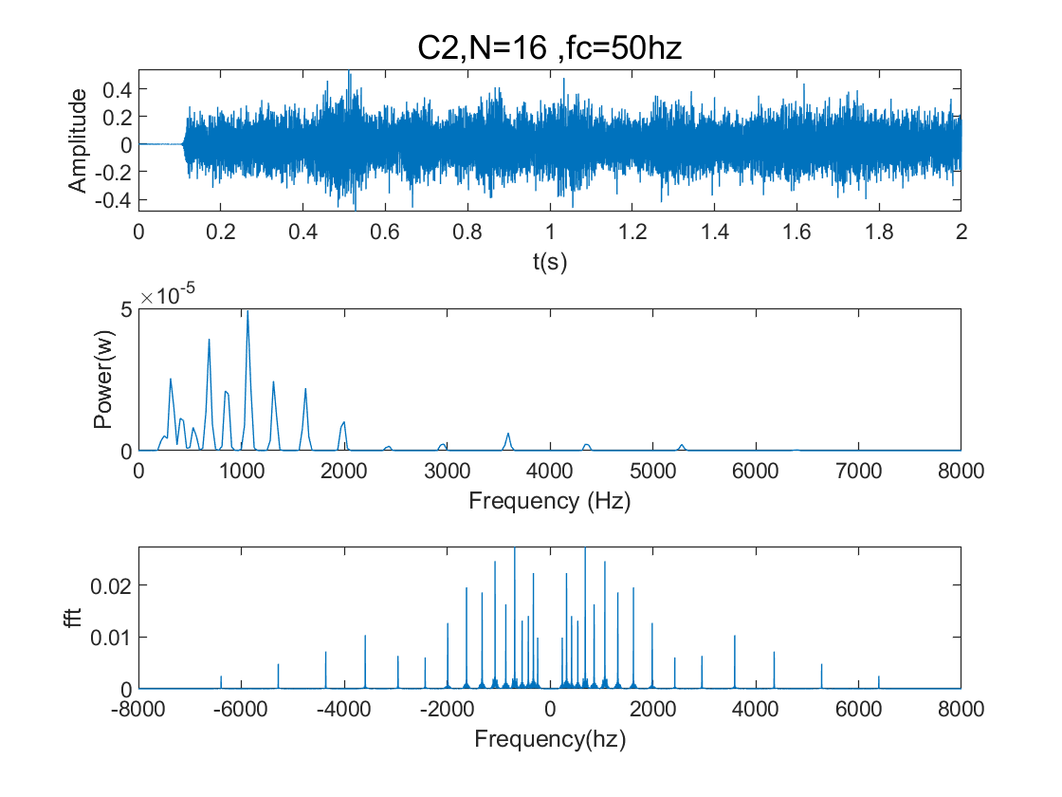
Results

Slide 34
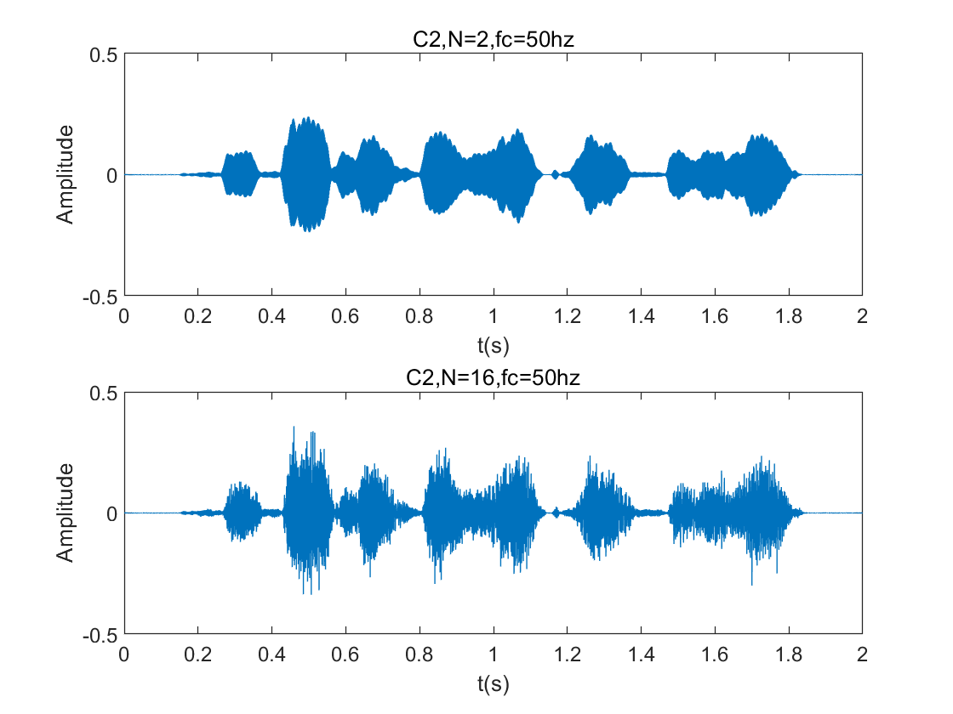
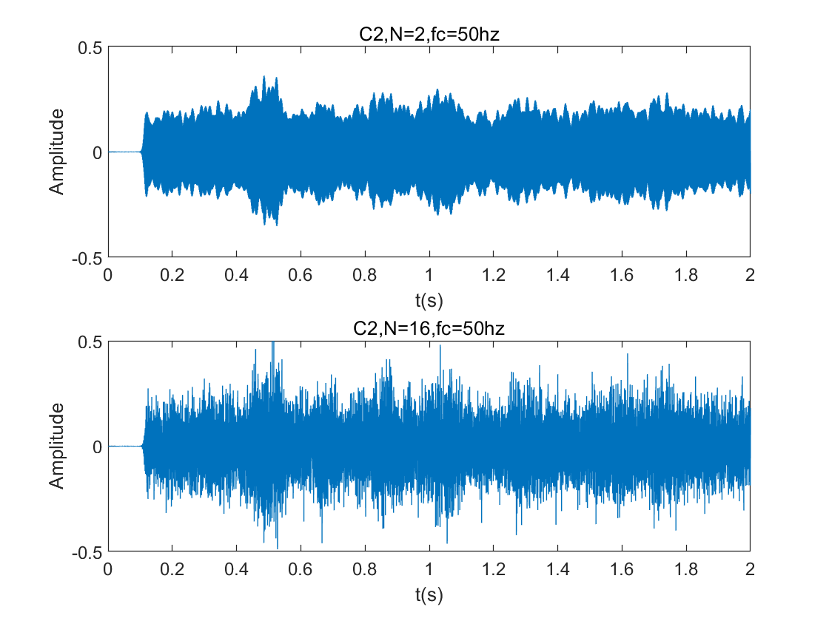
Conclusion
I compared N2 and N16 of the original signal with the signal with noise respectively. We can see from the figure that when N=2, the byte of the speech signal is not clearly distinguished from noise, and what we heard just now is almost noise. When N=16, there is a distinct distinction between speech signal and noise. Note: In a certain range, the larger N is, the smaller the masking effect of noise is.

Slide 35
Task-4 周安然

Slide 36
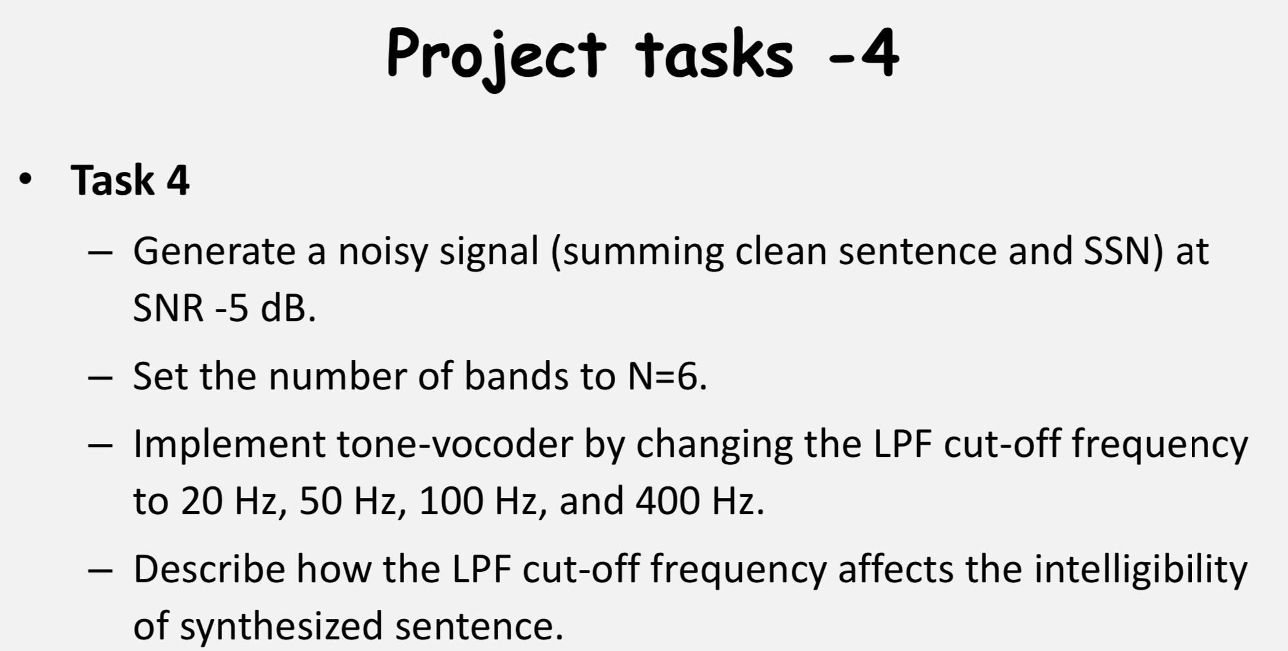

Slide 37
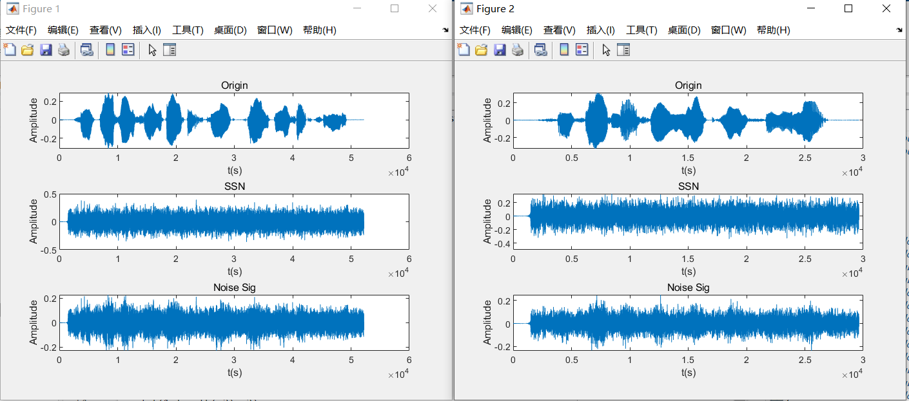
Original Signal and Noisy Signal

Slide 38
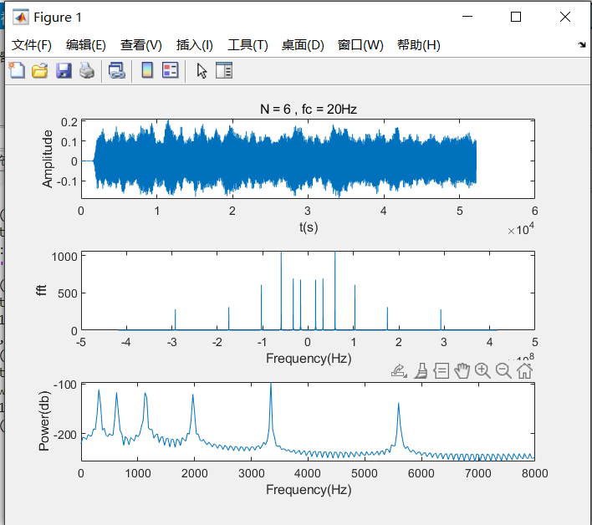
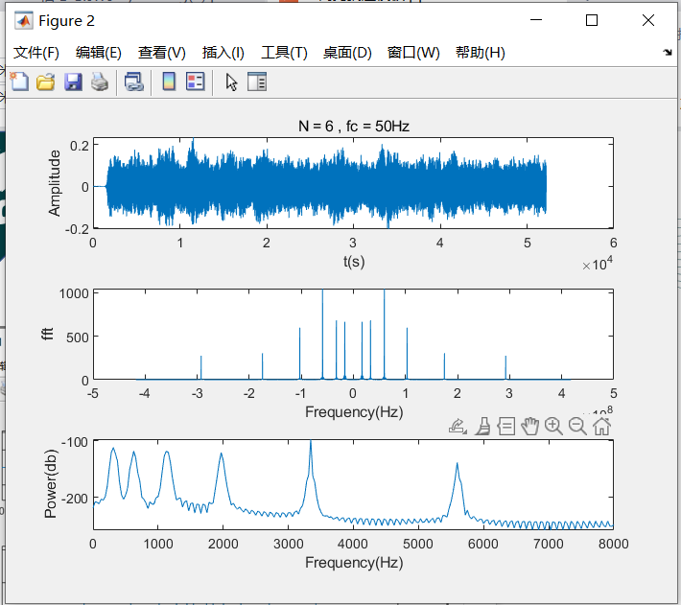

Results

Slide 39
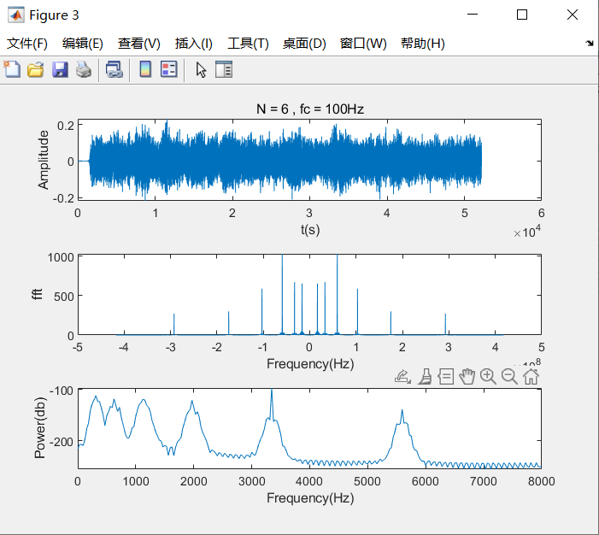

Results

Slide 40
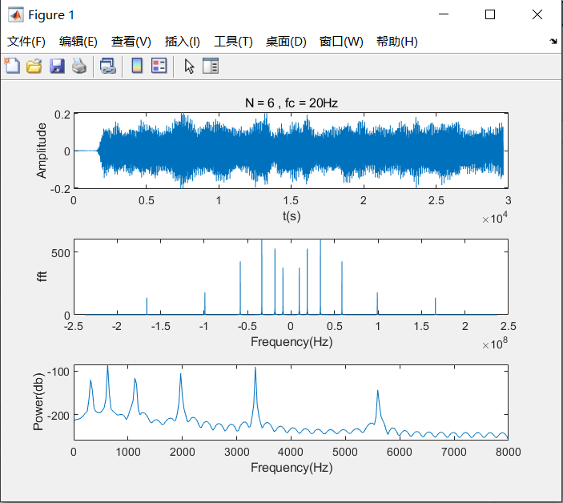
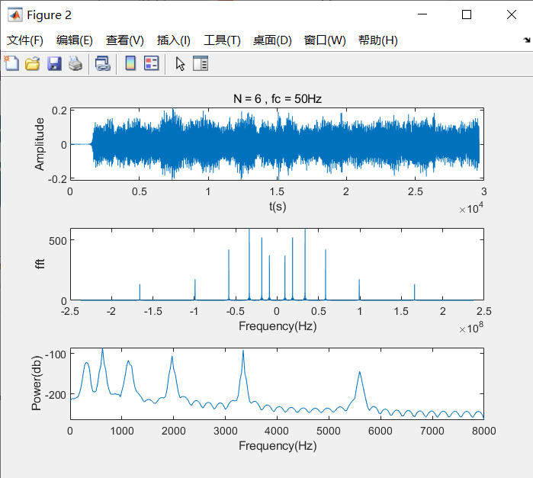
Results

Slide 41

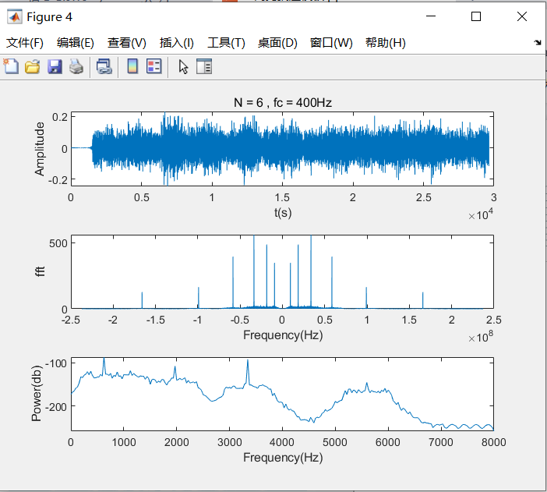
Results

Slide 42
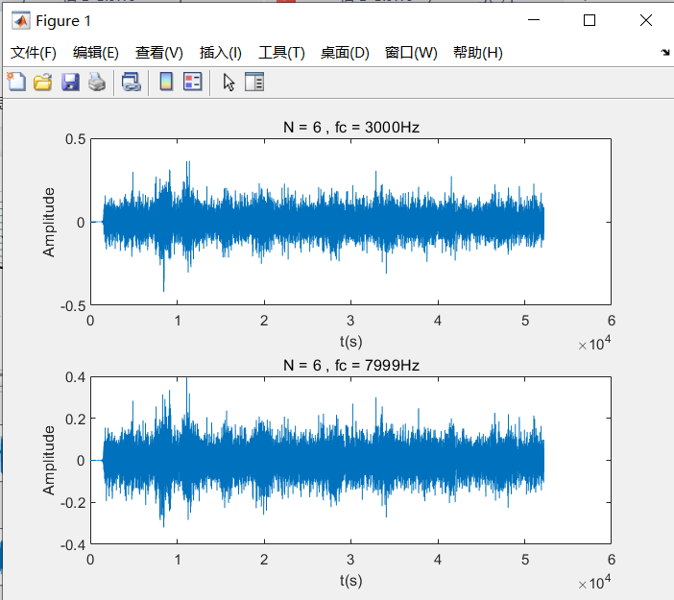
Conclusion
Speech-shaped-noise greatly interfers the intelligibility of synthesized sentence.
In the case where N is same, the larger the LPF cut-off frequency is within a certain range, the clearer the output.
If LPF cut-off frequencyis too large, the output signal will be distorted.

Slide 43
Thanks For Watching！

